Slide 1
Performance Evaluation of Object Detection Algorithms for Brain Tumor Detection in Medical Image Analysis
Group Members
Venkatesh Katta- AP20110010144
Supradha M - AP20110010657
Sai Monika P - AP20110010637
Sandhya N - AP20110010684
Under the guidance of
Prof. Anusha Nalajala

Slide 2
Table of Contents
Objective
Introduction
Problem statement
Methodologies
System Architecture
Results
Conclusion
References

Slide 3
Research Objectives
Our research aims to automate brain tumor classification and detection using deep convolutional neural networks(CNN), and Yolo (v8) aiming for superior accuracy and efficiency.
We seek to leverage the advantages of our proposed method, including improved classification accuracy and efficiency in tumor detecting.
Our research aims to develop a robust and reliable automated system for brain tumor detection, leveraging advanced deep learning techniques to enhance the speed, accuracy, and accessibility of diagnosis, ultimately improving patient outcomes and healthcare efficiency.

Slide 4
Introduction to the project
This project proposes an automated deep learning approach for accurate detection and classification of brain tumors using CNN and Yolo(V8) from Magnetic Resonance Imaging (MRI) scans.
Object detection technology in the medical field harnesses advanced algorithms and artificial intelligence to identify and locate specific objects within medical images.
These objects, ranging from tumors to fractures, are vital for accurate diagnosis and treatment planning. By analyzing images from various modalities such as X-rays, MRIs, and CT scans, this technology aids healthcare professionals in efficiently detecting abnormalities.
Here we used CNN Architecture for the Classification and Recognition of the images.
On the other hand we used Yolo V8(You Only Look Once) model which used for the real-time object detection.

Slide 5
Problem Statement
Automated methods utilizing artificial intelligence (AI) techniques are desperately needed, as brain tumor identification by Magnetic Resonance Imaging (MRI) presents several hurdles. In order to effectively classify and detect brain tumor images, this study suggests a deep convolutional neural network (CNN) model Detecting brain tumors accurately in medical images is crucial for effective diagnosis and treatment planning. Current methods rely heavily on manual annotation, leading to time-consuming processes and inconsistent results. Object detection models offer a promising solution but face challenges in adapting to 3D medical imaging data. To improve brain tumor detection efficiency and accuracy, there is a need for specialized object detection frameworks tailored for 3D medical images. This study aims to develop such a framework, YOLO, to enhance healthcare outcomes by facilitating faster and more reliable tumor detection. The principal aim is to compare the accuracies given by CNN and YOLO(v8).

Slide 6

Dataset Description
Name – Brain Tumor MRI Dataset
We have taken our dataset from Kaggle website
We have 500 images in the dataset for the Training
And 100 images for Testing

Slide 7
Existing System
The typical method for object recognition in 3D medical images involves employing segmentation and models are utilized to generate voxel-based annotations for objects of interest, enhancing the model's precision. However, this method comes with certain drawbacks. Generating accurate voxel markers for medical images is time- consuming and requires many experts to ensure the quality of the labels. Due to interindividual variability, precise segmentation of organs or lesions can be problematic with undefined structural boundaries that may or may not include relevant information from adjacent tissues. Even when provided with high-quality labels, segmentation models face difficulties in precisely delineating target structural areas and frequently need post-processing to address missing volumes and eliminate falsely identified ones. In general, this makes the training cost of segmentation models too high and may reduce the predictive capabilities of diagnostic or classification models.
Disadvantages
Existing approaches have lower precision and recall levels, resulting in low efficiency and requiring more time for image classification, which could delay the patient’s treatment.

Slide 8
Proposed System
Deep learning has recently been used in studies to boost the effectiveness of computer-aided medical diagnostics in brain cancer investigation. They play an essential role in the healthcare profession and act as valuable tools in various vital disorders, including brain disease diagnosis and skin cancer image analysis. DL methods based on transfer learning and fine-tuning are preferred and widely used for the classification of Brain tumors. The motivation of this research is to conduct extensive experimentation using deep convolutional neural networks, transfer learning, and fine-tuning to automate the process of brain tumor classification and detection.
Stage 1 (CNN) and Stage 2 (YOLO) object detection algorithms are performed parallelly for better training of our proposed model.
The results show that the proposed model with an overall accuracy of 92.87% for CNN and 96% for YOLO in terms of classification and detection.

Slide 9
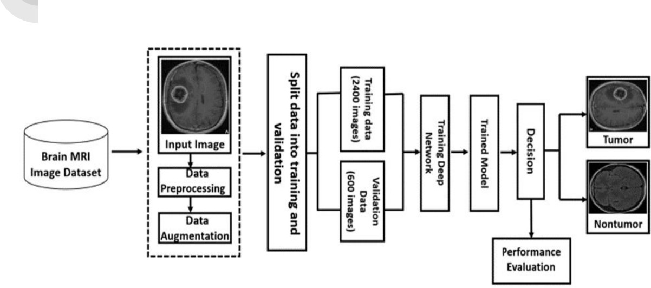
System Architecture

Slide 10
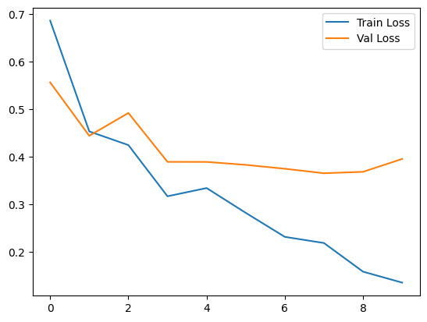
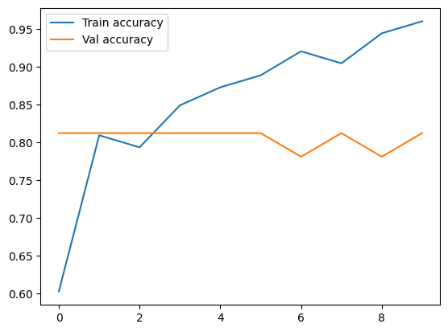
Loss and Accuracy
The performance of a deep learning (DL) model is measured by both loss and accuracy.
Lower loss indicates a more efficient model because it signifies fewer mistakes in predictions.
2/2 [==============================] - 1s 176ms/step –
loss: 0.2923 - accuracy: 0.9250
Test Loss: 0.29225218296051025
Test Accuracy: 0.925000011920929

Slide 11
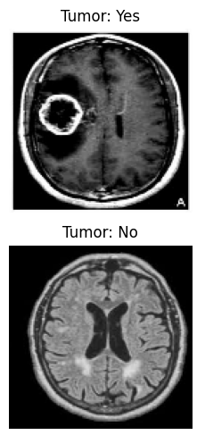
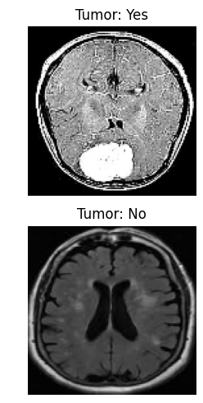
Visuals and Results (CNN)
In this model we have trained the model with some datasets. After training the model we have given a set of test images and the model has classified the results accordingly.

Slide 12
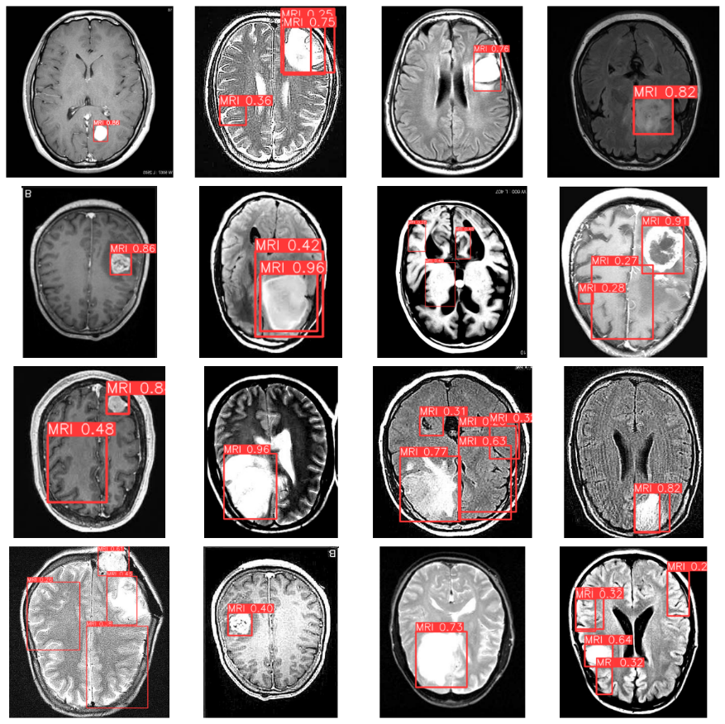
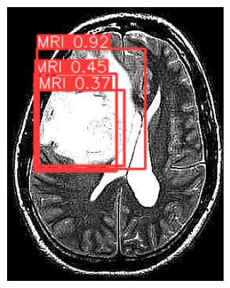
Visuals and Results (YoloV8)
In this model we have trained the model (best.pt) with some datasets. After training the model we have given a set of test images and the model has classified the results accordingly.

Slide 13
Conclusion
Key Findings:
Developed a CNN and Yolo models for brain tumor detection from MRI scans.
Achieved a remarkable validation accuracy of 96.87%, showcasing the model's exceptional performance.
Future Directions:
Future research will expand the proposed approach to encompass other medical imaging modalities such as x-rays, CT scans Etc
Exploration of additional convolutional models and transfer learning designs to further enhance brain tumor in medical image detection.
Scope of Further Work:
Application of the proposed approach to diverse medical images lays the foundation for advancing diagnostic capabilities and improving patient outcomes.

Slide 14
References
Redmon J, Farhadi A: YOLO9000: Better, Faster, Stronger. 2017 IEEE Conference on Computer Vision and Pattern Recognition, DOI: 10.48550/arXiv.1612.08242, 2016
Jocher G, et al.: ultralytics/yolov5: v7.0 - YOLOv5 SOTA Realtime Instance Segmentation, DOI: 10.5281/zenodo.7347926, 2022
U. Baid, et al.: The RSNA-ASNR-MICCAI BraTS 2021 Benchmark on BrainTumor Segmentation and Radiogenomic Classification, DOI:10.48550/arXiv.2107.02314, 2021
B. H. Menze, A. Jakab, S. Bauer, J. Kalpathy-Cramer, K. Farahani, J. Kirby, et al.: The Multimodal Brain Tumor Image Segmentation Benchmark (BRATS). IEEE Transactions on Medical Imaging 34:1993-2024, 2015

Slide 15


